Slide 1
Conjoint analysis: Optimization method
Ref: Srinivasan V. and A.D. Shocker (1973), “Linear programming techniques for multidimensional analysis of preferences,” Psychometrika, 38: 337 – 369.

Slide 2
Geometric explanation
(X₁, X₂) = Coordinates of the Ideal option
O₁
O₄
d₁
Attribute 2
x
(Y₁₁, Y₁₂) = Coordinates of O₁
d₃
O₂
O₃
d₁ = Distance between O₁ and ideal point
Attribute 1

Slide 3
The logic
A methodology for analyzing individual differences in preference judgements with regard to a set of options.
The product options are represented as points in a multi-attribute space.
Different subjects correspond to different “ideal points” that denote their “most-preferred” location.
Given two options, the customer is supposed to prefer that option which is “closer” to his/her ideal point.
As a measure of distance, normally either the Euclidean metric or the weighted Euclidean metric is used.

Slide 4
Illustrative example
 | Attribute 1 | Attribute 2
Product 1 | 1.5 | 12
Product 2 | 10 | 8
Product 3 | 2.3 | 4
Product 4 | 1 | 7
Pairs | Pairwise preference data
 | Prefers | Over
(1,2) | 1 | 2
(1,3) | 1 | 3
(1,4) | 4 | 1
(2,3) | 2 | 3
(2,4) | 2 | 4
(3,4) | 4 | 3

Slide 5
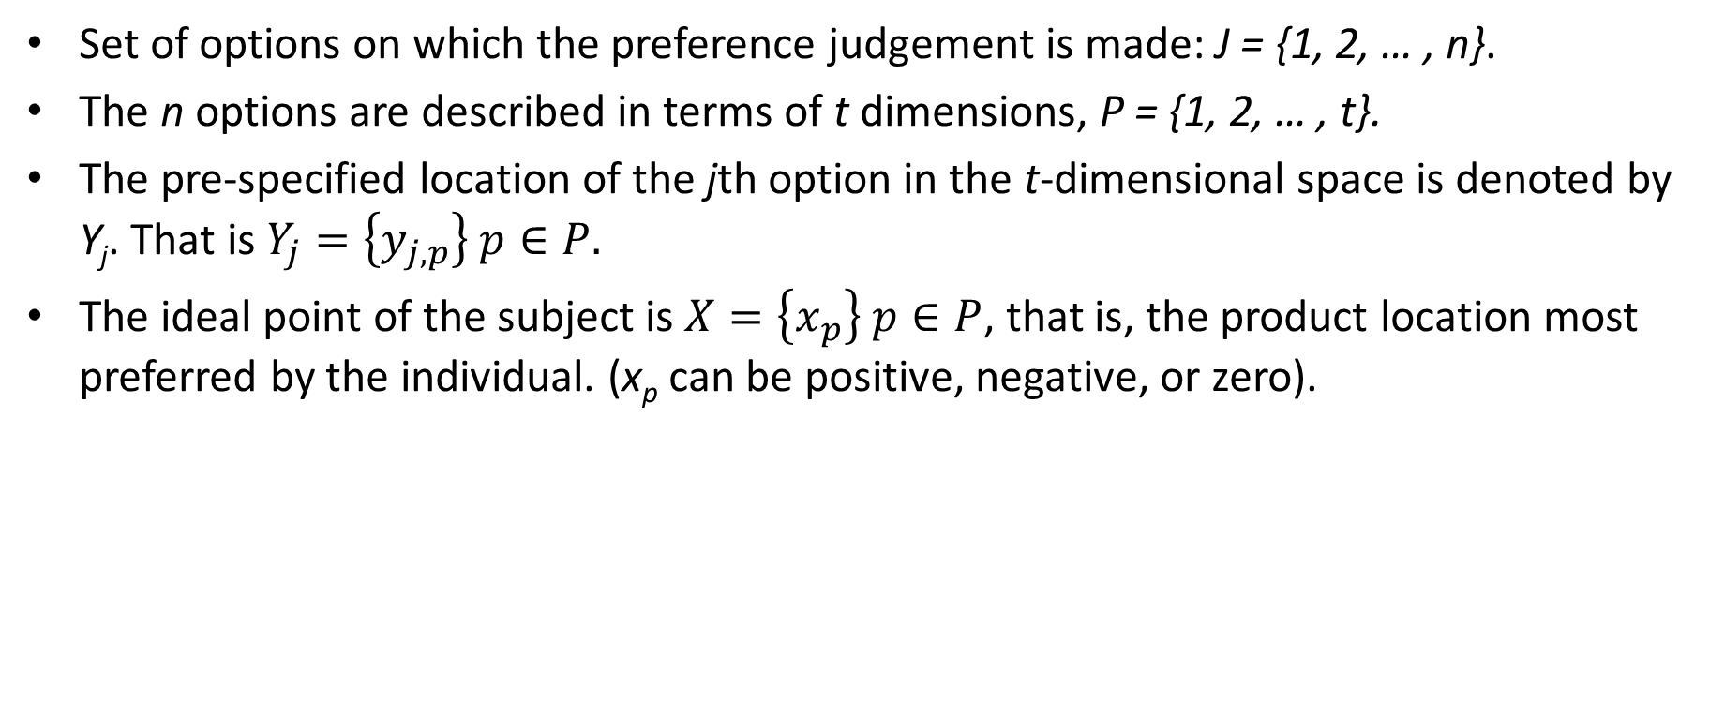
LP model using pairwise judgements: Notations
Set of options on which the preference judgement is made: J = {1, 2, … , n}.
The n options are described in terms of t dimensions, P = {1, 2, … , t}.
The pre-specified location of the jth option in the t-dimensional space is denoted by Y_{j}. That is$Y_{j}=\left\{y_{j,p}\right\} p∈P.$
The ideal point of the subject is $X=\left\{x_{p}\right\} p∈P$, that is, the product location most preferred by the individual. (x_{p} can be positive, negative, or zero).

Slide 6

Problem specific notations
We have four variants to be compared: $n=4. j=1, 2, 3, 4.$
The 4 (n = 4) options are described on 2 dimensions. $t=2. P=\left\{1, 2\right\}.$
Specified location of the j^{th} option in the 2-dimensional space is denoted by $Y_{j}$. This has two coordinates: $Y_{j}=\{Y_{j1},Y_{j2}\}$. We have $Y_{1}, Y_{2},Y_{3}, and Y_{4}.$
Ideal point for this consumer is $X=\{X_{1},{ X}_{2}\}$.

Slide 7
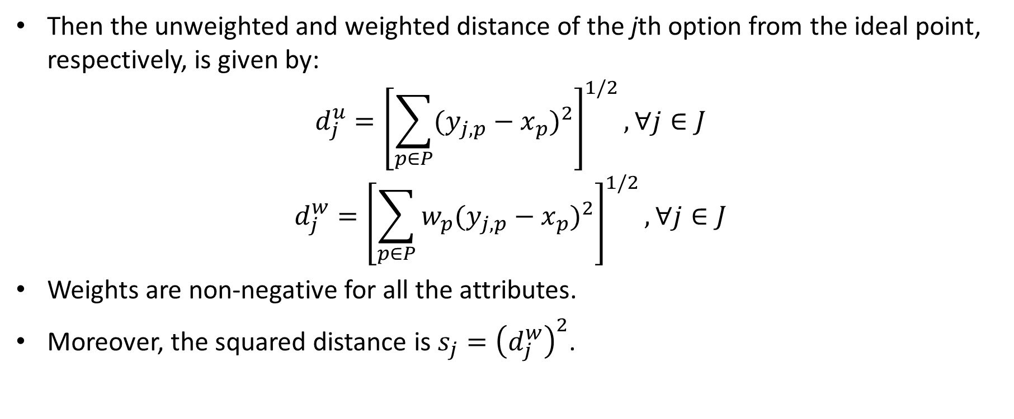
LP model using pairwise judgements: Notations
Then the unweighted and weighted distance of the jth option from the ideal point, respectively, is given by:
$$d_{j}^{u}={\left[\sum_{p∈P}{{(y_{j,p}−x_{p})}^{2}}\right]}^{1/2}, ∀j∈J$$
$$d_{j}^{w}={\left[\sum_{p∈P}{{w_{p}(y_{j,p}−x_{p})}^{2}}\right]}^{1/2}, ∀j∈J$$
Weights are non-negative for all the attributes.
Moreover, the squared distance is $s_{j}={\left(d_{j}^{w}\right)}^{2}$.

Slide 8
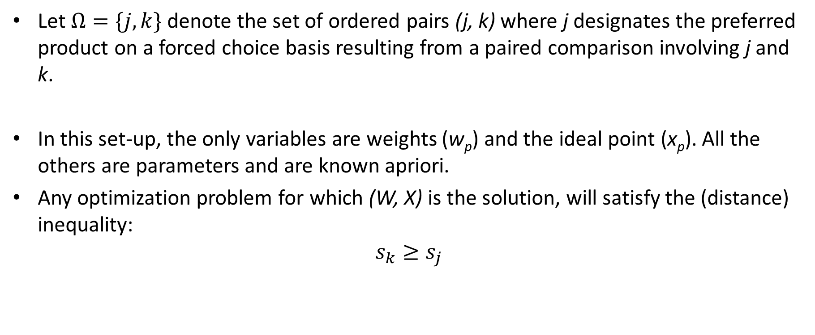
LP model using pairwise judgements: Notations
Let $Ω=\{j, k\}$ denote the set of ordered pairs (j, k) where j designates the preferred product on a forced choice basis resulting from a paired comparison involving j and k.
In this set-up, the only variables are weights (w_{p}) and the ideal point (x_{p}). All the others are parameters and are known apriori.
Any optimization problem for which (W, X) is the solution, will satisfy the (distance) inequality:
$$s_{k}≥s_{j}$$

Slide 9
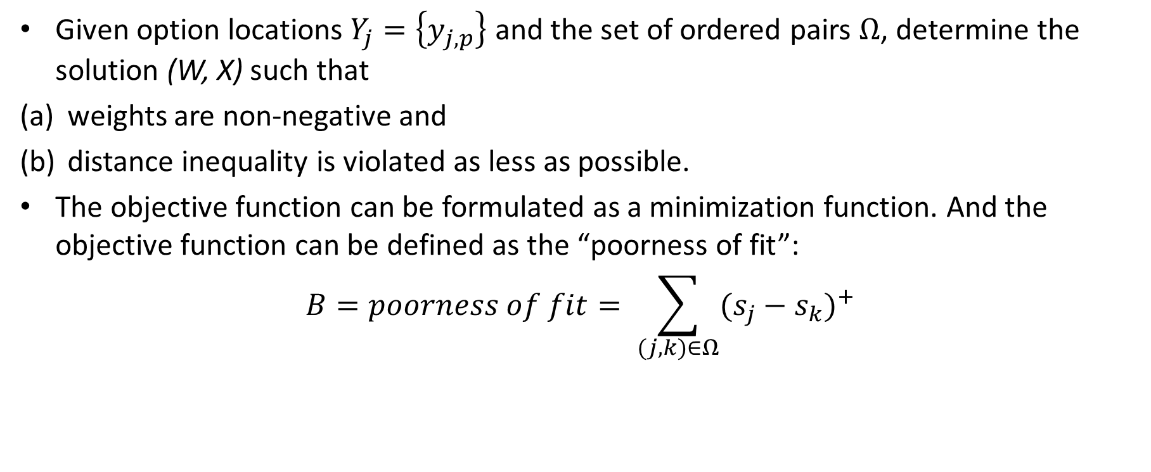
LP model using pairwise judgements: Formulation
Given option locations $Y_{j}=\left\{y_{j,p}\right\}$ and the set of ordered pairs $Ω$, determine the solution (W, X) such that
weights are non-negative and
distance inequality is violated as less as possible.
The objective function can be formulated as a minimization function. And the objective function can be defined as the “poorness of fit”:
$$B=poorness of fit= \sum_{(j,k)∈Ω}{{(s_{j}−s_{k})}^{+}}$$

Slide 10
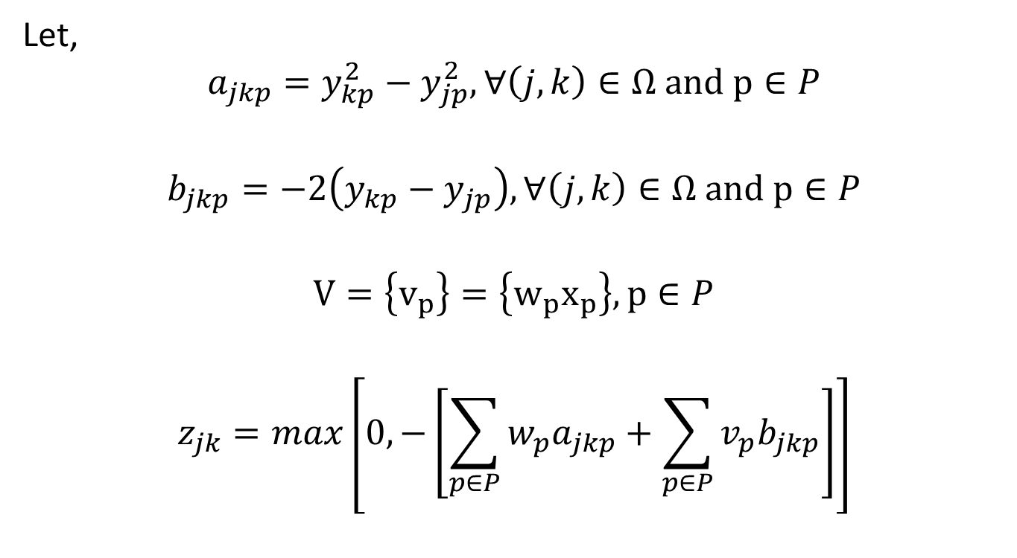
Final formulation
Let,
$$a_{jkp}=y_{kp}^{2}−y_{jp}^{2}, ∀\left(j,k\right)∈Ω and p∈P$$
$$b_{jkp}=−2\left(y_{kp}−y_{jp}\right), ∀\left(j,k\right)∈Ω and p∈P$$
$$V=\left\{v_{p}\right\}=\left\{w_{p}x_{p}\right\}, p∈P$$
$$z_{jk}=max\left[0,−\left[\sum_{p∈P}{w_{p}a_{jkp}}+\sum_{p∈P}{v_{p}b_{jkp}}\right]\right]$$

Slide 11
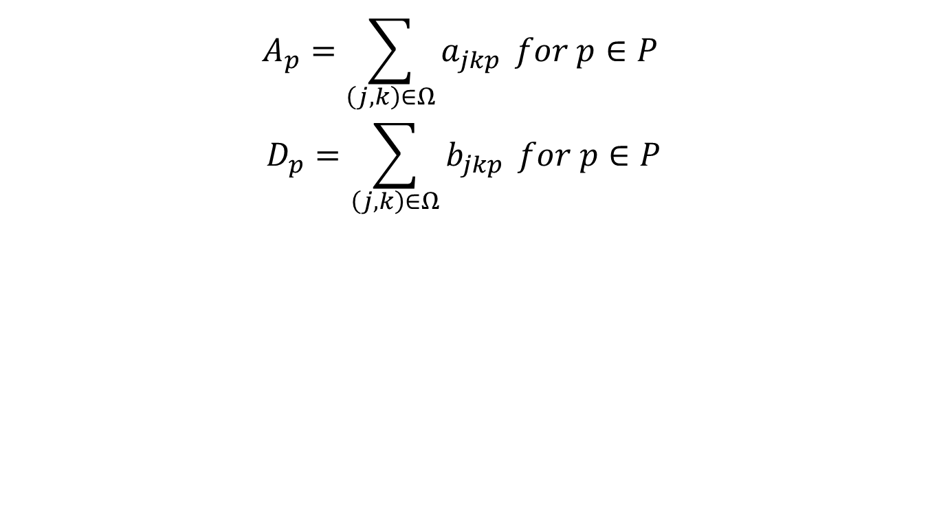
Final formulation
$$A_{p}=\sum_{\left(j,k\right)∈Ω}{a_{jkp}} for p∈P$$
$$D_{p}=\sum_{\left(j,k\right)∈Ω}{b_{jkp}} for p∈P$$

Slide 12
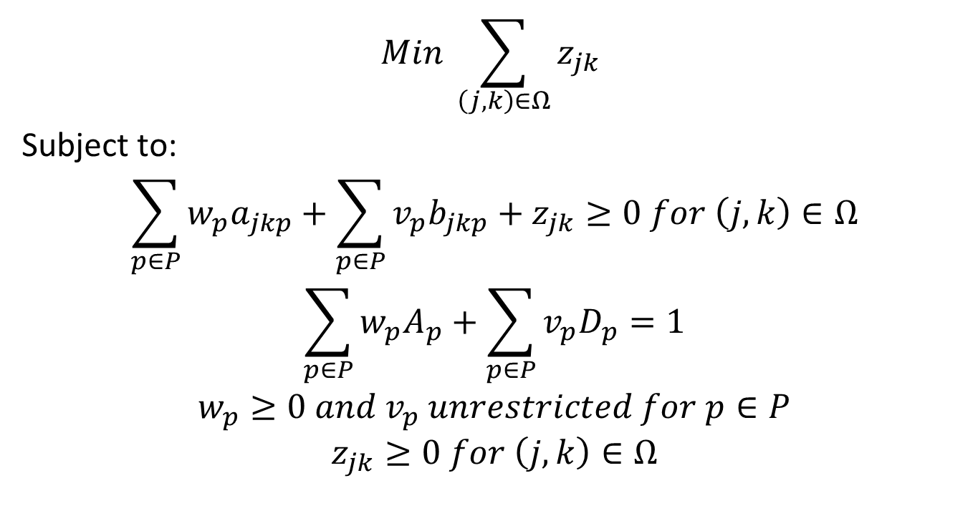
Final formulation: LP
$$Min \sum_{\left(j,k\right)∈Ω}{z_{jk}}$$
Subject to:
$$\sum_{p∈P}{w_{p}a_{jkp}}+\sum_{p∈P}{v_{p}b_{jkp}}+z_{jk}≥0 for \left(j,k\right)∈Ω$$
$$\sum_{p∈P}{w_{p}A_{p}}+\sum_{p∈P}{v_{p}D_{p}}=1$$
$$w_{p}≥0 and v_{p} unrestricted for p∈P$$
$$z_{jk}≥0 for \left(j,k\right)∈Ω$$

